Slide 1
Linear Algebra
线性代数
Zongbin Chen YMSC, Tsinghua University
陈宗彬 清华大学数学科学中心
Email: zbchen@tsinghua.edu.can

Slide 2
Course information
Textbook:
Gilbert Strang: Introduction to linear algebra
David Lay, Steven Lay, Judie MacDonald, Linear algebra and its applications. (有中文版）
Grade: Homework 30%, Midterm 30%, Final 40%
Office Hour: Monday 19h-21h
Teaching assistant：LI Ziyu (李子钰)，XIAO Zida (肖子达).

Slide 3
What it is about?
Solve linear equations （解线性方程组）
Matrix algebra （矩阵代数）
Vector spaces （向量空间）

Slide 4
Examples

Slide 5
Matrix form

Slide 6

Why in matrix form? More convenient and more powerful!

Slide 7
Back to the example

Slide 9
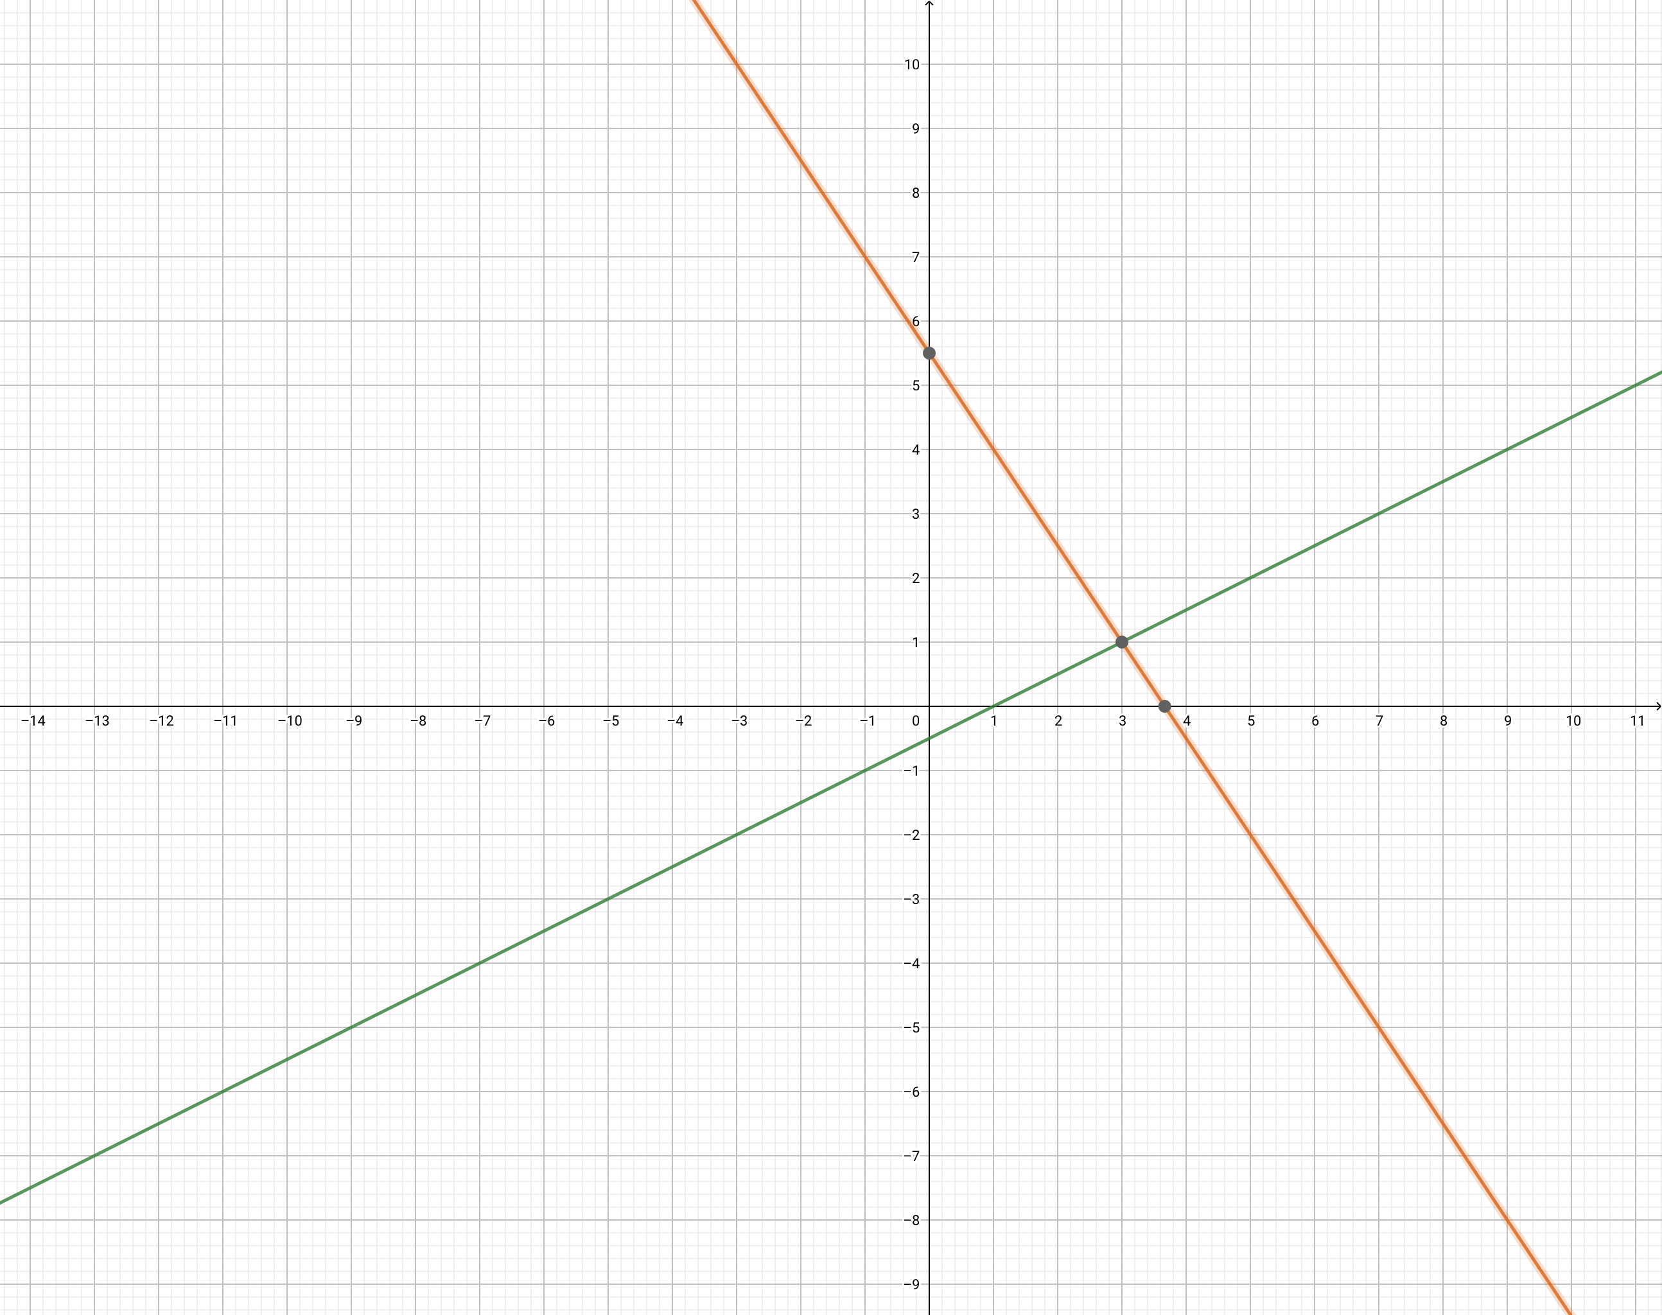

The geometry

Slide 10


Rigorously, what is a line and a plane?
Need the concept of vector（向量） and vector space （向量空间）
Definition: (Vectors in $R^{n}$)

Slide 11
Our convention is to use column vectors（列向量）
Addition of vectors （向量的加法）

Slide 12

Scalar multiplication of vectors（向量的数乘）
The set $R^{n}$ of all the vectors, equipped with the vector addition and scalar multiplication, is called the n-dimensional real vector space（n维实向量空间）.

Slide 13
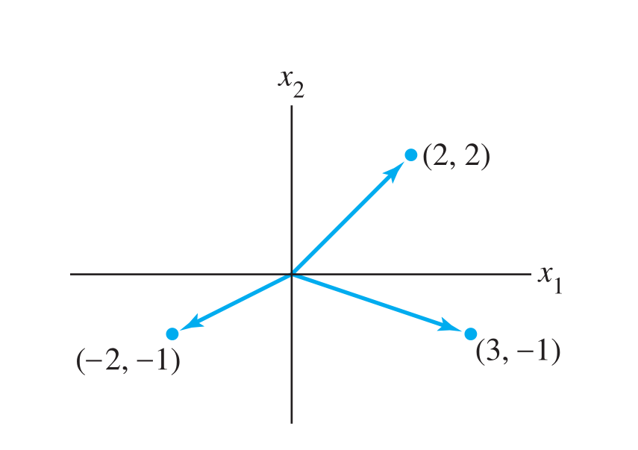

Geometric description of $R^{2}$

Slide 14
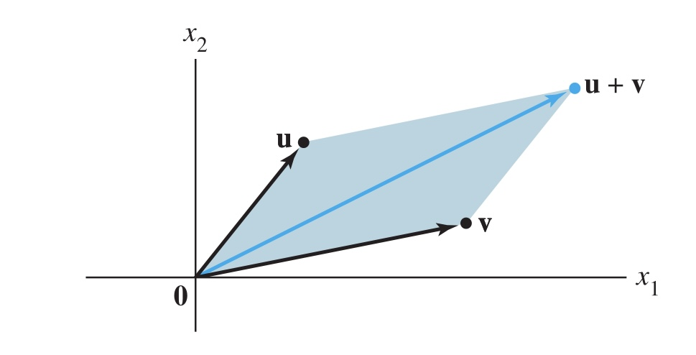
Parallelogram rule for addition（向量加法 的平行四边形法则）

Slide 15
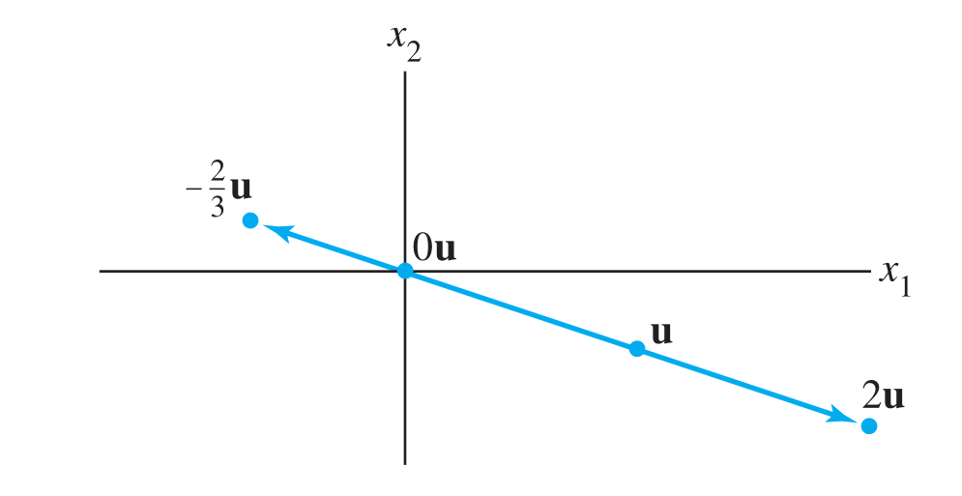
Scalar multiplication（数乘）

Slide 16
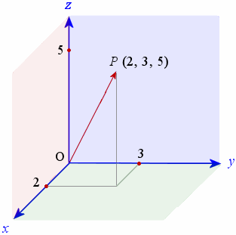

Vectors in $R^{3}$
The rule of parallelogram applies to addition of vectors in $R^{3}$, and scalar multiplication has the same meaning.

Slide 17
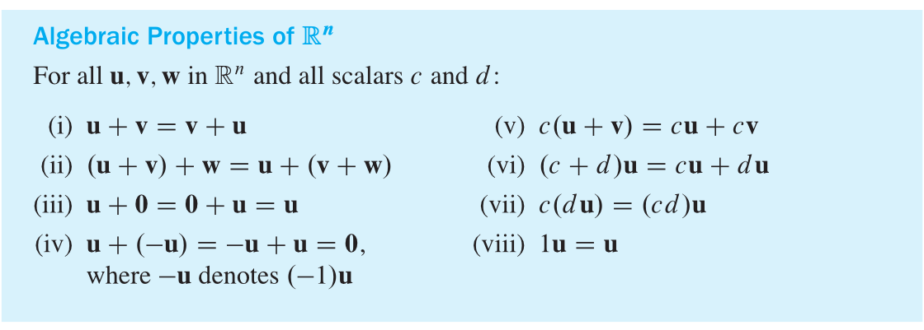
By definition, we can verify the following:

